Slide 1
FURNITURE TRANOÏ JUNE 24
GAÎTE LYRIQUE

Slide 2
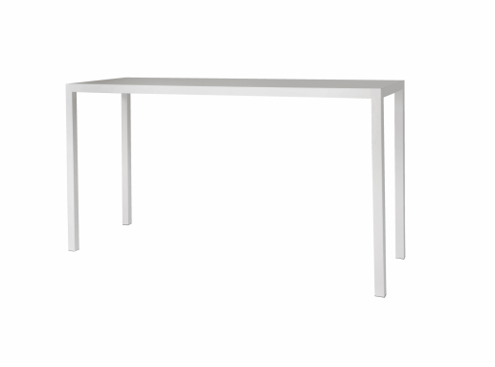
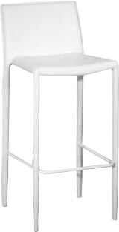
SHARED CENTRAL FURNITURES – LEVEL -1
HIGH CHAIR
HIGH TABLE
L.150 x W.65 x H.45
L.42 x W.46 x H.76/100 cm
L.200 x W.70 x H.110 cm
Non contractual photos

Slide 3
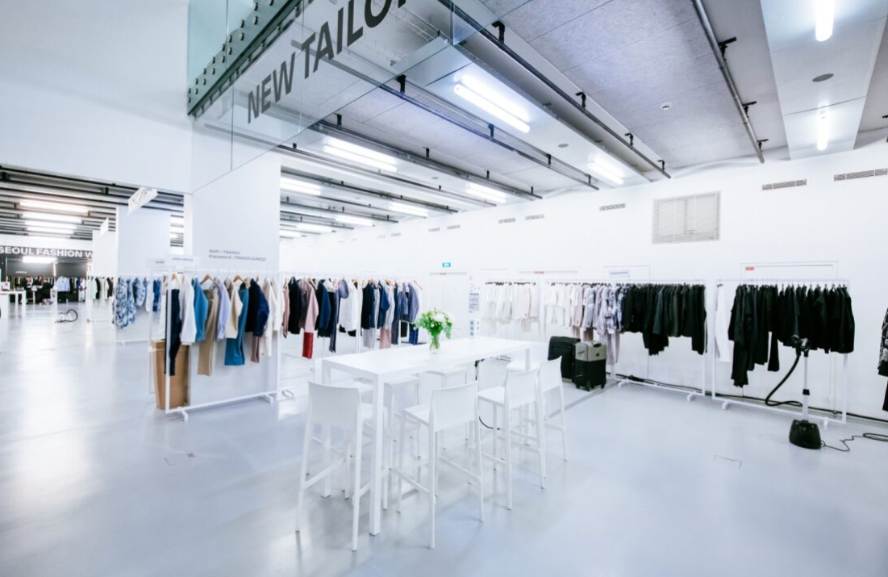
SHARED CENTRAL FURNITURES – LEVEL -1
Non contractual photos

Slide 4
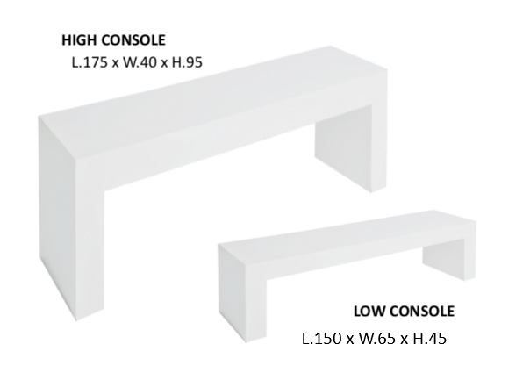
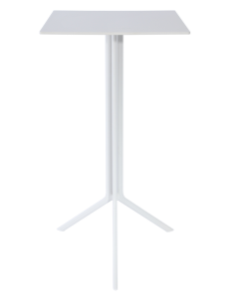
ACCESSORIES BOOTH
HIGH TABLE
HIGH CHAIR
L.150 x W.65 x H.45
L.60 x W.60 x H.110 cm
L.42 x W.46 x H.76/100 cm
Non contractual photos

Slide 5
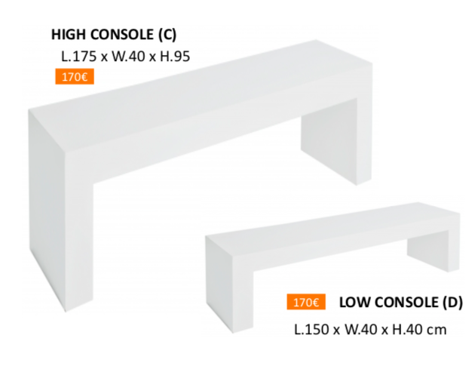
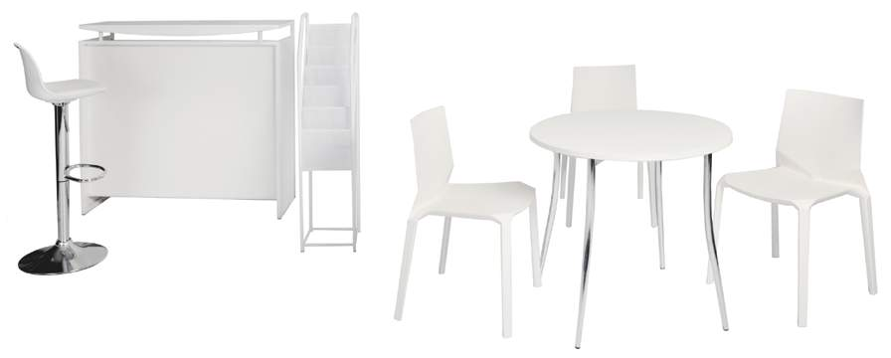
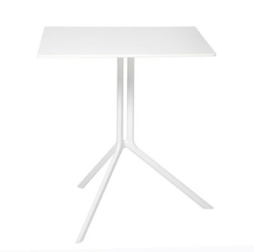

ACCESSORIES BOOTH >9M2
CHAIR
TABLE
L.150 x W.65 x H.45
L.54 x W.54 x H.46 cm
L.70 x W.70 x H.75 cm
Non contractual photos

Slide 6
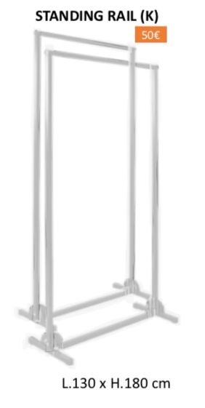
READY-TO-WEAR BOOTH<9M2
HIGH TABLE
HIGH CHAIR
L.60 x W.60 x H.110 cm
L.42 x W.46 x H.76/100 cm
Non contractual photos

Slide 7
READY-TO-WEAR BOOTH>9M2
CHAIR
TABLE
L.54 x W.54 x H.46 cm
L.70 x W.70 x H.75 cm
Non contractual photos

Slide 8
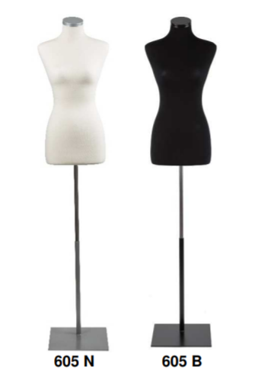


OPTIONAL
ELECTRIC SOCKET
LOCKER
MIRROR
STOCKMAN
L.47,5 x W.47,5 x H.70 cm
W.46 x H.120
Women Adjustable height
chest 86 - waist 65 - hip 90
Non contractual photos

